Slide 1
Zeitgeist
An evolving blockchain for prediction markets and futarchy

Slide 2
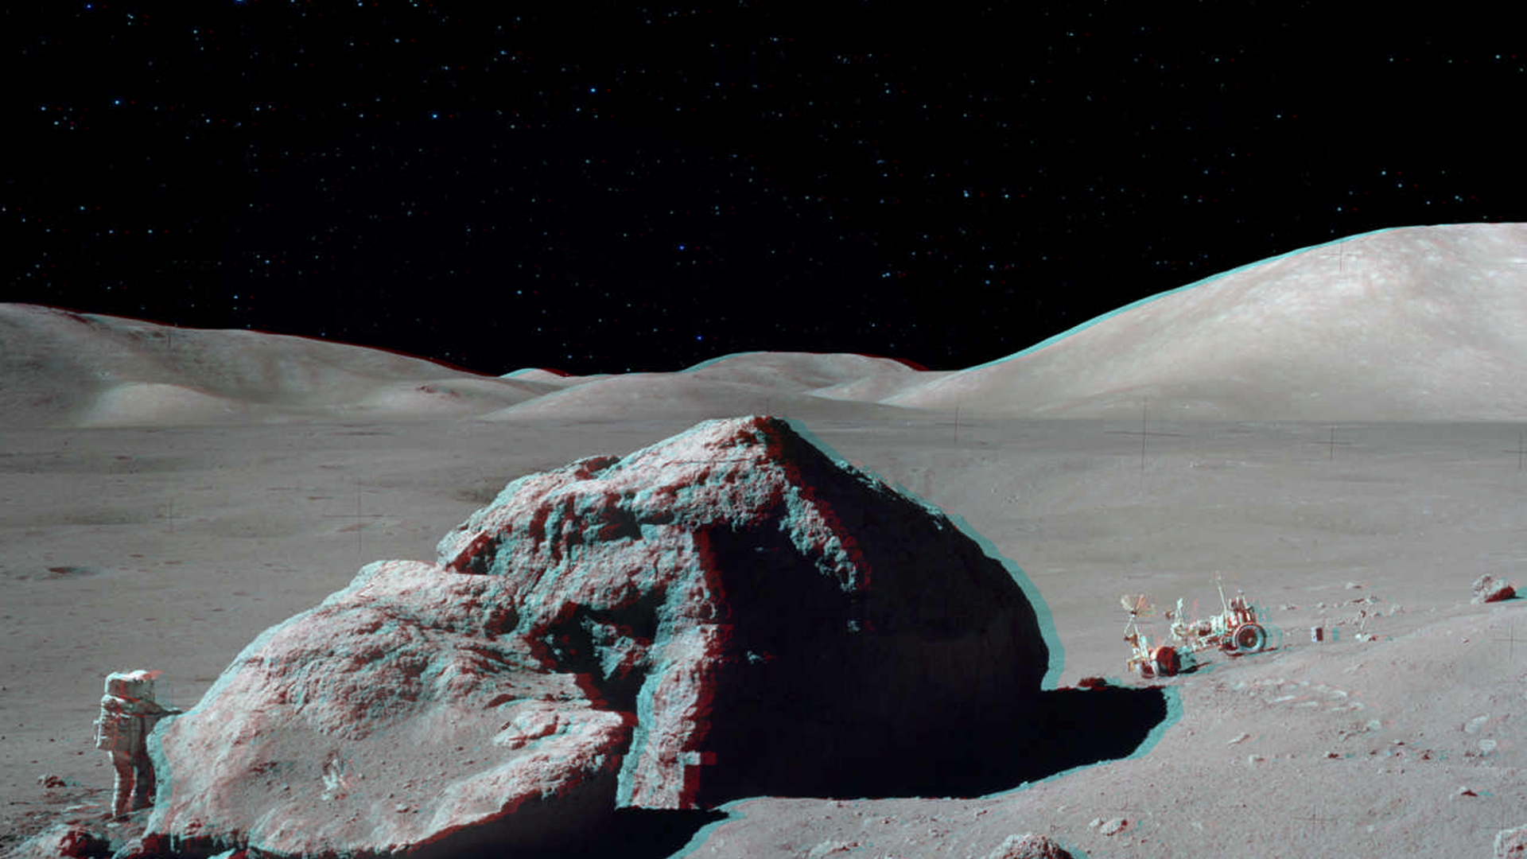


01 | Zeitgeist Introduction
AGENDA
02 | Futarchy
03 | Prediction Market
04 | Seer Program
05 | Campaign

Slide 3


Zeitgeist Introduction
01

Slide 4
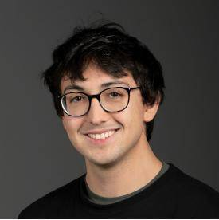
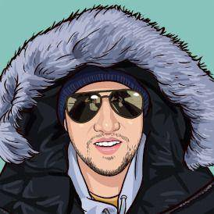
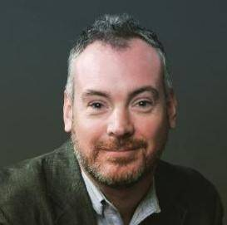
Team
Logan Saether is a technologist who has a background in engineering projects in both the Ethereum and Polkadot ecosystems. At Web3 Foundation, Logan helped to build critical tooling and operation around the launch of both Kusama and Polkadot, as well as wrote extensive documentation about Polkadot including major contributions to the Polkadot Wiki.
Chris Hutchinson is one of the industry’s best community builders. He started his blockchain career at Status.im, where he led the community efforts during the 2017 - 2018 Ethereum boom. In early 2019, he joined Web3 Foundation to build the Polkadot Ambassador Program from scratch, which now boasts over 1500 active members from over 300 cities worldwide.
David Perry has an extensive career and experience with prediction market platforms. In 2005, he co-founded one of the first commercial prediction market software companies, Consensus Point. Since then he has worked to drive prediction market adoption in hundreds of organizations, including General Electric, Qualcomm, Best Buy, and the U.S. Government.

Slide 5
How it works
1
Create Your Shares
An individual, known as an aggregator, wishes to obtain a prediction on a particular variable. They create a new market and pose a question about the variable they want to test.
2
Trade on Your Beliefs
Traders, whom each hold different views and information regarding the variable in question will take position in the market by buying market shares.
3
Report the Outcome
After the conclusion of the event, the designated oracle will report the outcome of the question to Zeitgeist.

Slide 6
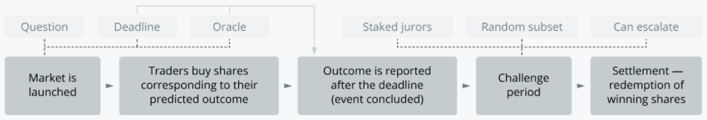
How it works

Slide 7
On-chain Court System
ZTG holders can stake their tokens to join the court. These stakers are randomly selected whenever there is an oracle dispute over a specific market.
01
The stakers of the court will be responsible for choosing the true results of the market. The court’s decision may be challenged, which will increasingly increase the number of jurors selected—increasing the stakes each time.
02
If a subsequent appeal finds that the jurors have incorrectly resolved Oracle's decision, they will be slashed and confiscated.
03
After a certain number of quorums have been created and the real result of the market is asked, if there is still a dispute, the case will be transferred to a global vote of all ZTG holders to report the result.
04

Slide 8
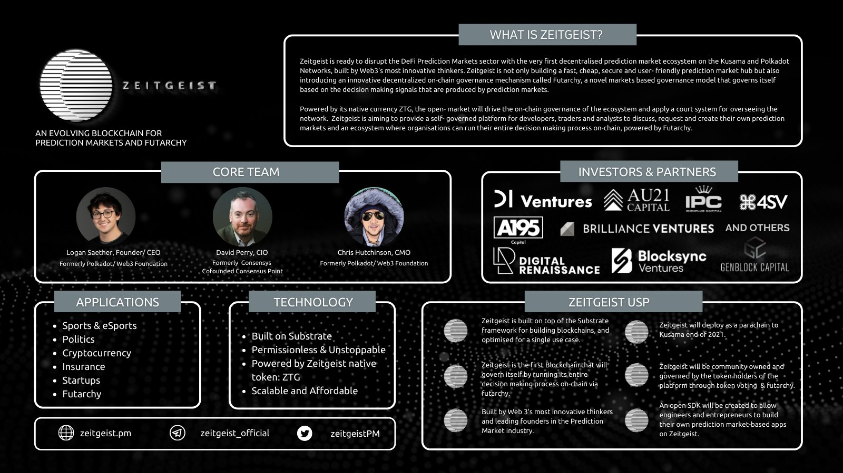
1
Zeitgeist
Presentation

Slide 9
Prediction Market
02

Slide 10
Prediction Markets
Markets that trade the outcomes of future events
They are infomation aggregation mahchines, the demonstrate the collective wisdom of participants
They provide incentive for information to emerge
Quick to adapt to new information, hard to manipulate

Slide 11
Prediction Markets
1. Binary Markets
There are only two possible outcomes in a prediction market.
Will Joe Biden win the President of the United States? Yes/No
2. Scalar Markets
The result of prediction market is a specific values.
The total amount of precipitation in a place in July 2021 xx millimeter
3. Combinatorial Markets
Predictive markets where bets are made on combinations of outcomes.
2021 NBA Championship

Slide 12
The past and prospects of prediction markets
In terms of sports and e-sports alone, more than $208 billion will be invested in sports-related prediction markets in 2020.
On the Ethereum prediction platform, the transaction volume on the Augur platform alone about the US election forecast exceeds $6.8 million
As early as 2014, when the first blockchain platform Augur was launched, the prediction market was touted as one of the best blockchain use cases. Reasons for failure to erupt:
1) Poor usability / UX
2) High Ethereum gas fee
3) Poor liquidity

Slide 13
Futarchy
03

Slide 14
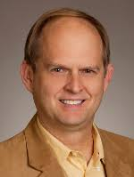
Futarchy: Vote on Values, But Bet on Beliefs
Futarchy is a governance system that makes policy decisions based on signals generated by prediction markets.
Its concept was originally proposed by Robin Hanson in a short article titled "Vote on Values, But Bet on Beliefs", in which he clarified how Futarchy might improve certain aspects of the current democratic operation - the most obvious is to create a better way to judge the potential benefits of policy decisions.
However, in scenarios such as corporate governance, public policy decision-making or urban planning, futarchy usually exists as a rather unfamiliar concept that is not suitable for application.
We believe that blockchain is very suitable for futarchy experiments and will use futarchy as one of the key parts of Zeitgeist's decentralized on-chain governance.

Slide 15
Seer Program
04

Slide 16
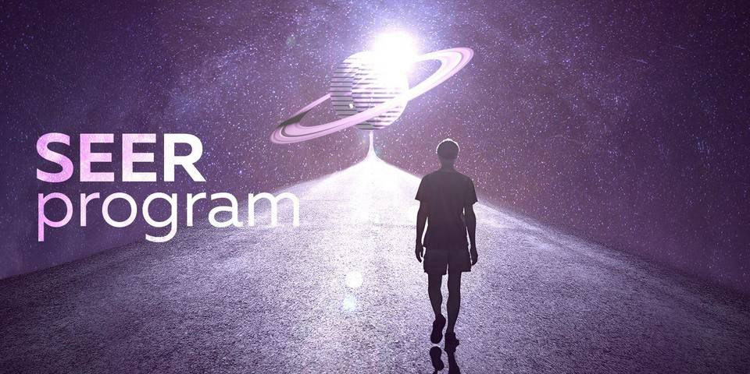
The Seer program is a community that will help shape Zeitgeist and its related philosophy of prediction markets and Futarchy in the blockchain field.

Slide 17
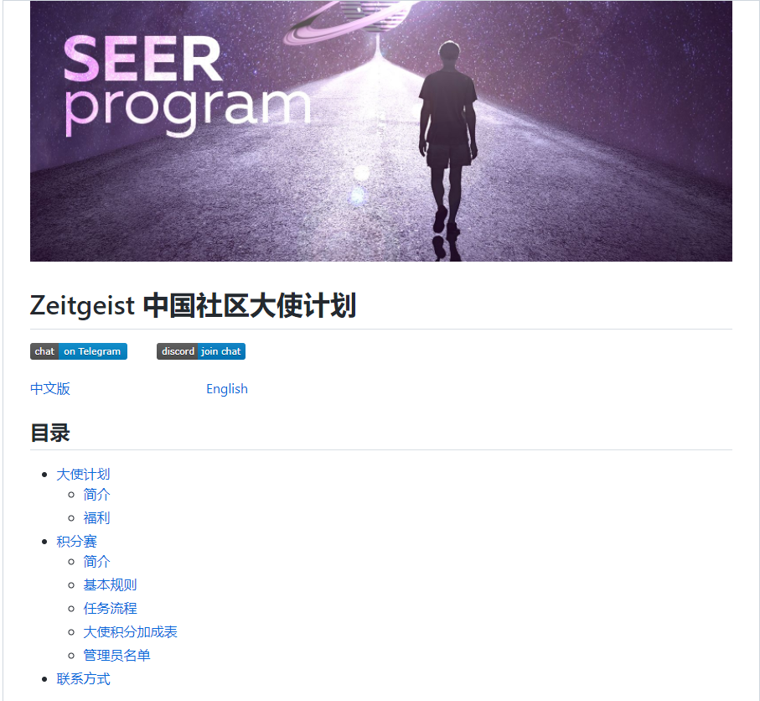
https://github.com/zeitgeistpm/Seer-For-China

Slide 18
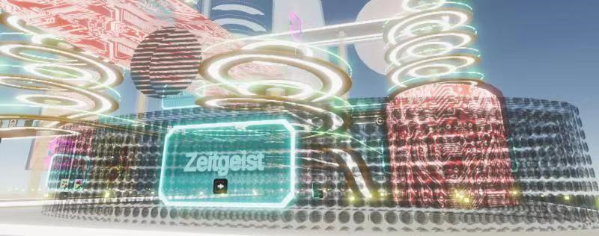
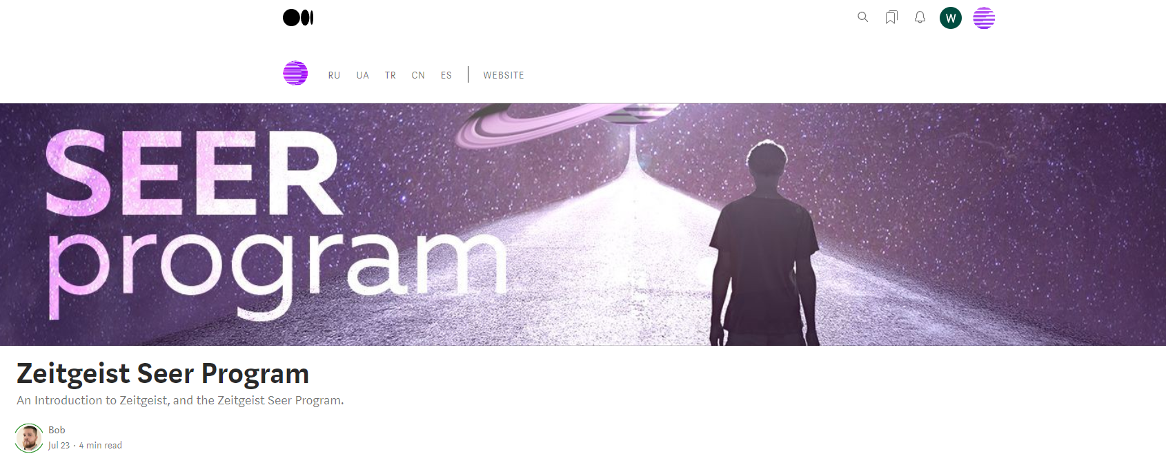

Slide 19
Campaign
05

Slide 20
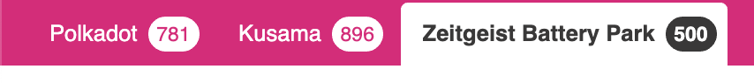
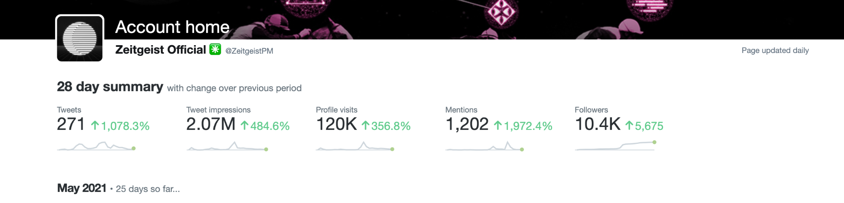
Kusama Derby
Our first testnet campaign.
Over 3000 sign-ups on Gleam.
We hit the limit of nodes on public telemetry. Currently more than 600 nodes are active on our testnet.
More than 1100 users paid $2.00 to get access to our testnet faucet (spam prevention).

Slide 21
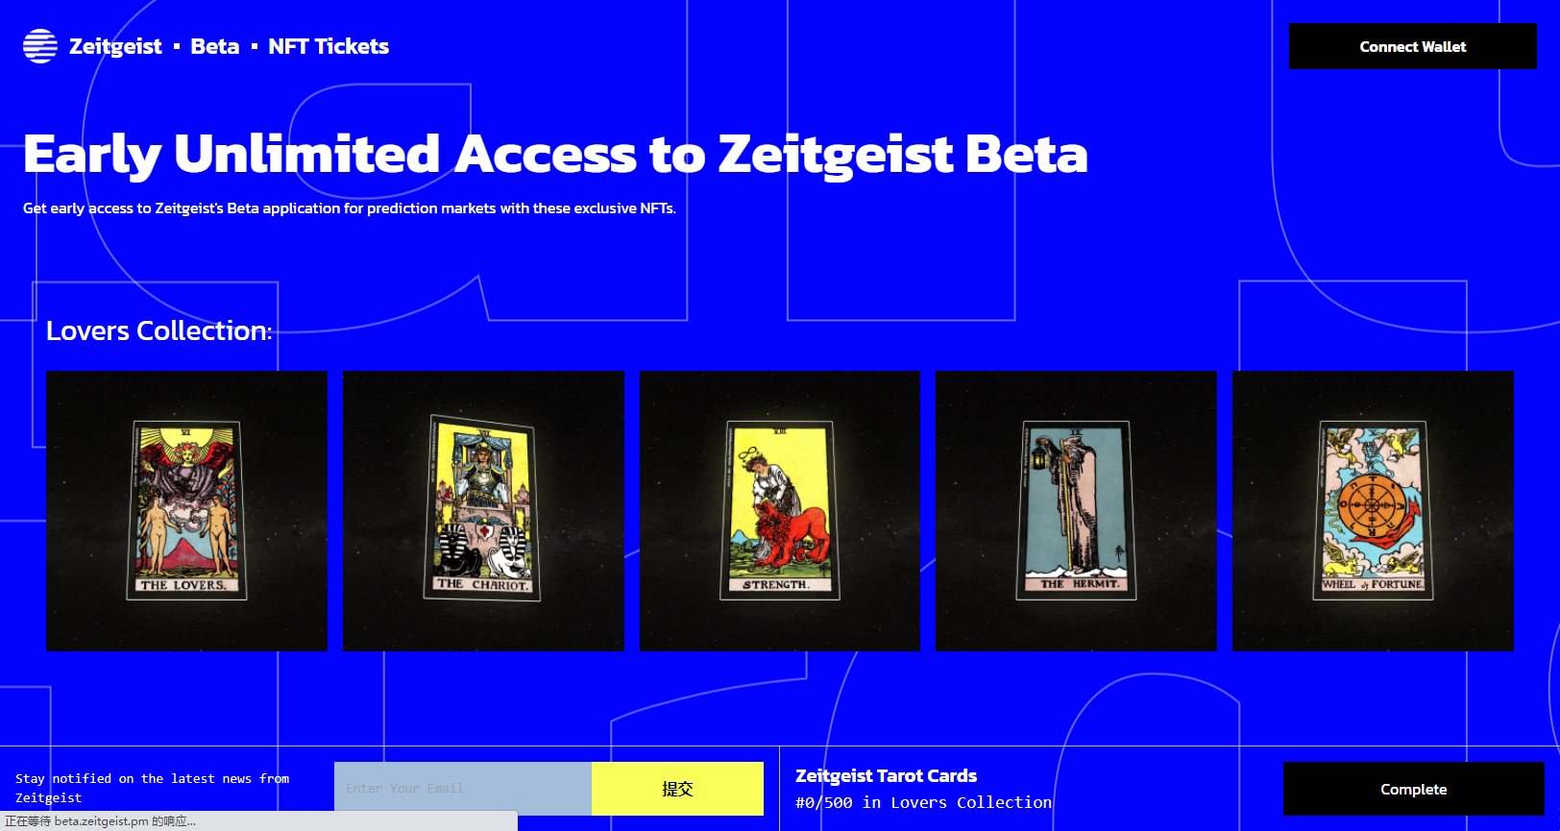

Slide 22
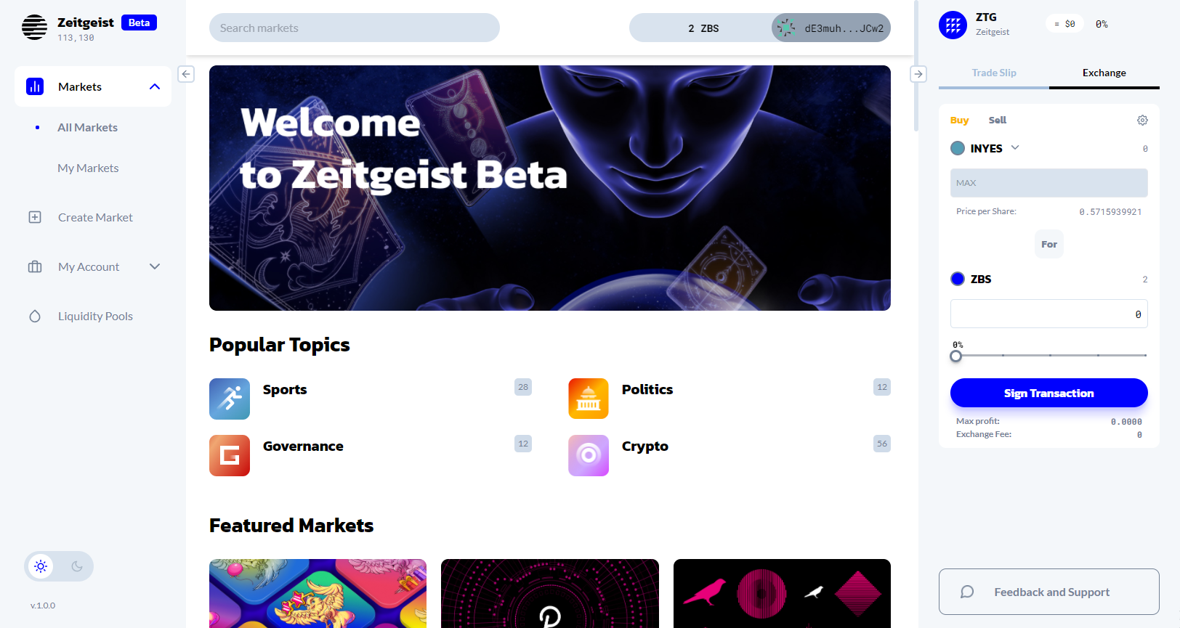

Slide 23
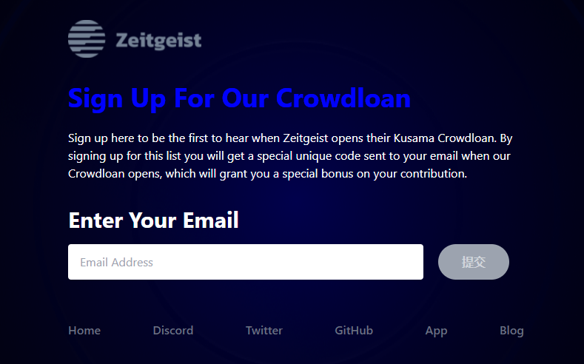
https://signup.zeitgeist.pm/

Slide 24
Thanks

